Slide 1
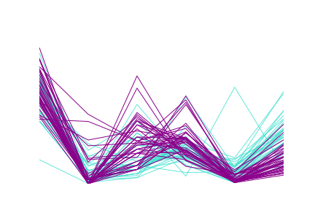
Upstroke:
Downstroke
Adaptation
Index
Rheobase
(pA)
Membrane Time Constant (ms)
Firing Rate
(spikes/s)
Input Resistance
(MΩ)
6
1
800
100
150
600
5
0.8
80
500
600
4
0.6
100
400
60
3
0.4
400
300
40
2
0.2
50
200
200
1
0.0
20
100
0
-0.2
0
0
0
0

